Slide 1




SEMESTER PROJECT
Semester 6
May 21 2022
6-ECE

Slide 2

Team Description
Preventing Phishing Attack on Voting System Using Machine Learning
Mentor
Rishali Rishu 19BEC1108
Dr. O Jeba Shiney
PROFESSOR
ELECTRONICS AND COMMUNICATION ENGINEERING UIE, CU
Sushant Kumar 19BEC1078

Slide 3
Preventing Phishing Attack on Voting _{METHODOLOGY}
System Using Machine Learning

Slide 4




Preventing Phishing Attack on Voting System Using Machine
Learning
Phishing is an attempt by an individual or a group to get personal confidential information from unsuspecting victims our system aims at providing a facility to cast vote for critical and confidential internal corporate decisions. It has the flexibility to allow the casting of votes from any remote place. The election is held in full confidentiality by applying appropriate security measures to allow the voter to vote for any participating candidate only
Secure
USER-FRIENDLY
One Click Use
Zero Cost

Slide 5


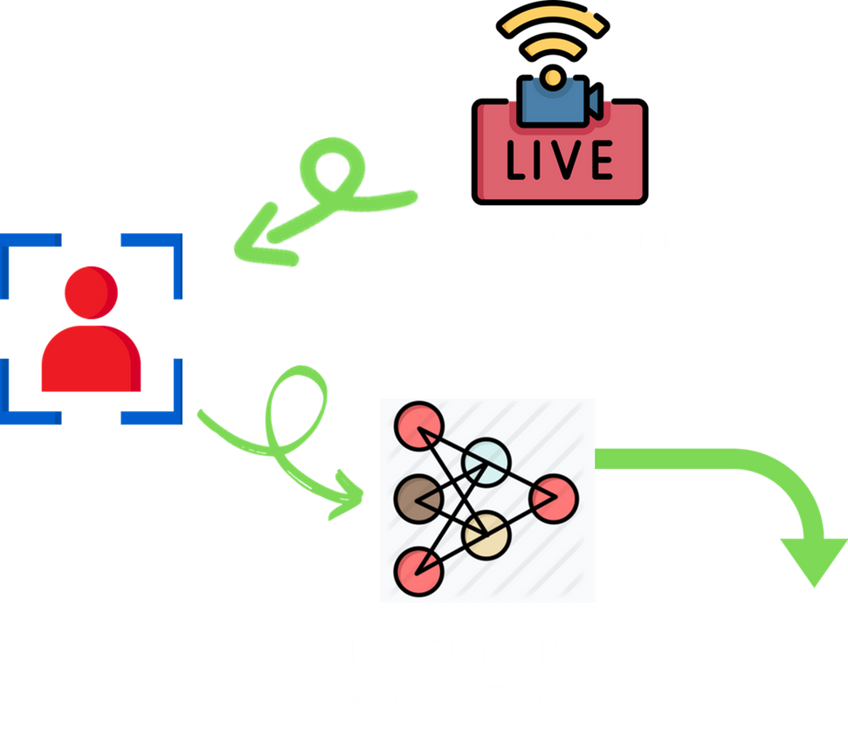


PROTOTYPE SKETCH
CODING & FRAMEWORK
SERVER
FACE DETECTION
OUTPUT
Identity Detected

Slide 6


FRAMEWORK
ANACONDA
Anaconda is a distribution of the Python and R programming languages for scientific computing (data science, machine learning applications, large-scale data processing, predictive analytics, etc
PYTHON LIBRARIES
A Python library is a reusable chunk of code that you may want to include in your programs/ projects. Compared to languages like C++ or C, Python libraries do not pertain to any specific context in Python. Here, a 'library' loosely describes a collection of core modules.

Slide 7
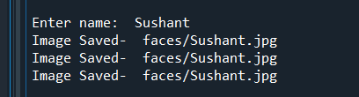
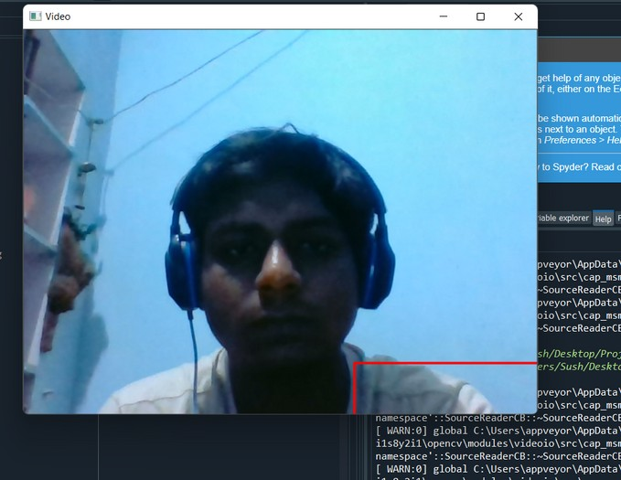
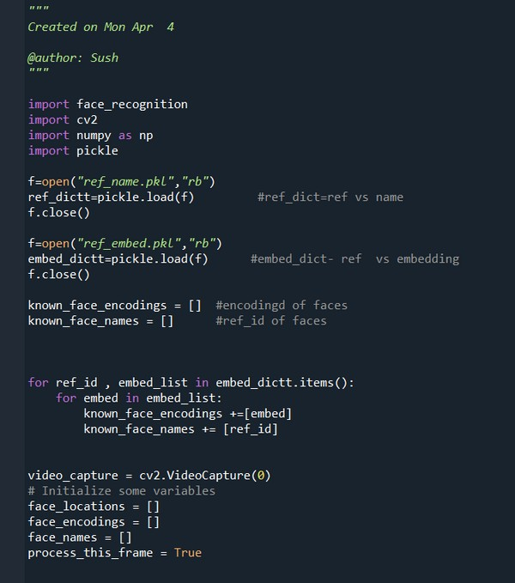
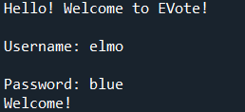
PROGRESSIVE PICTURES OF PROJECT

Slide 8

THANK YOU

